Slide 1
Applying the Principles
Two Examples

Slide 2
Example 1

Slide 3
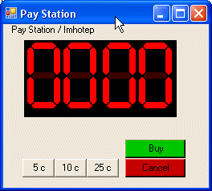
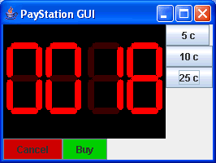
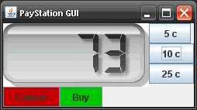
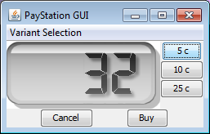
New Requirement
It would be nice with a simple GUI “to see something” instead of just xUnit tests...
“The GUI History of FRS” ☺
© Henrik Bærbak Christensen

Slide 4
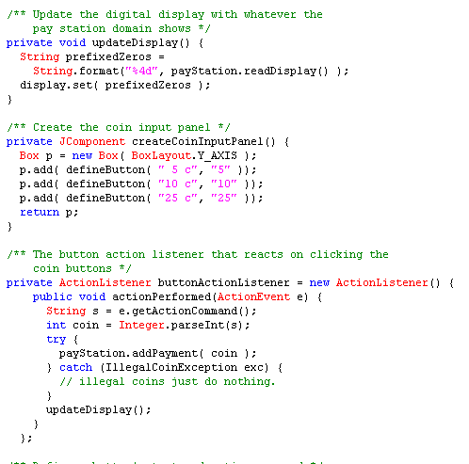
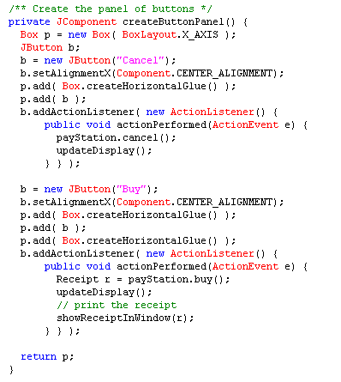
[Demo]
Run it
  Ant gui
Review GUI code
© Henrik Bærbak Christensen

Slide 5
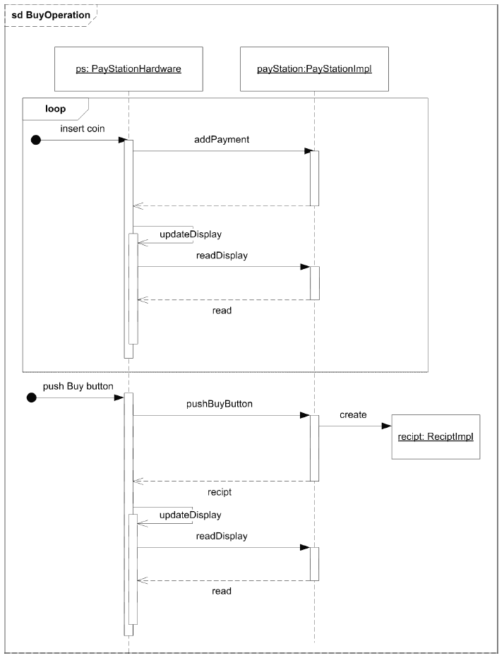
Analysis
Seq Diagram
  No difference in behaviour of a GUI versus real hardware!
© Henrik Bærbak Christensen

Slide 6
Conclusion
Any kind of user interface can operate the PayStation!
Wow – Change by addition...
How come we are so lucky?
© Henrik Bærbak Christensen

Slide 7
Design considerations
(3) Behaviour that may vary
  the same hardware must operate varying pay station implementations: AlphaTown, BetaTown, EpsilonTown...
(1) Variable behaviour behind interface
  PayStation interface...
(2) Compose behaviour by delegation
  Gui/Hardware does not itself calculate rates, issue receipts, etc., but lets an instance of PayStation do the dirty job...
© Henrik Bærbak Christensen

Slide 8
Result
The side effect of this decisions is that interface decouples both ways!!!
  Hardware may operate different kinds of PayStation implementations
    Alpha, Beta, Gamma, …
  Different kinds of user interfaces may operate the same PayStation implementation
<<interface>>
PayStation
*
*
<<interface>>
PayStationGUI
© Henrik Bærbak Christensen
Notes:
Demo: dSoftArk E09 / many-to-many

Slide 9
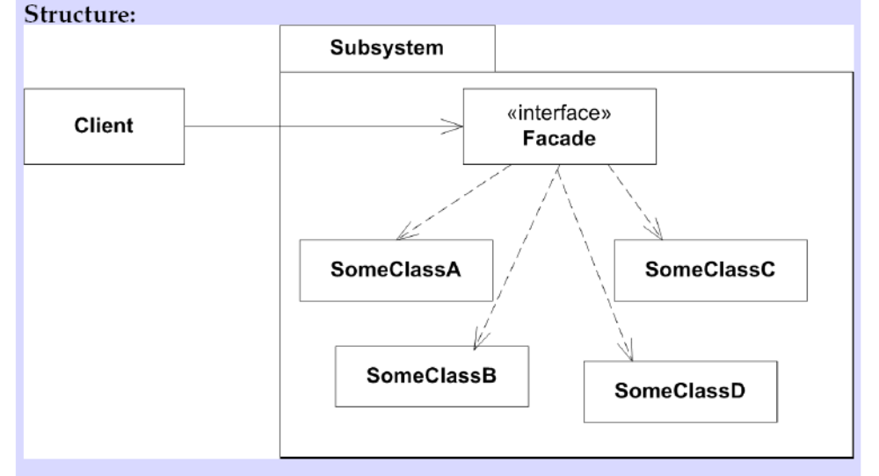
Automagical pattern?
PayStation is an example of the Facade pattern
© Henrik Bærbak Christensen

Slide 10
Consequences
Benefits
  Shields clients from subsystem objects
    (depends… Consider HotCiv)
  Weak coupling
    Many to many relation between client and façade
Liabilities
  Bloated interface with lots of methods
    Because façade must have the sum of responsibilities of the subsystem
  How to avoid access to the inner objects?
    Read-only interfaces; no access (require dumb data objects to be passed and parsed over the façade).
© Henrik Bærbak Christensen

Slide 11
Example 2

Slide 12
New Requirement
Alphatown wants to log all coin entries:
  [time] [value]
Example:
  14:05:12 5 cent
  14:05:14 25 cent
  14:55:10 25 cent
☺
© Henrik Bærbak Christensen

Slide 13

The 3-1-2 machinery
Let us look at the machinery:
③ Identify the responsibility whose concrete behaviour may vary
① Express responsibility as an interface
② Let someone else do the job
How does this apply?
What is 3-1-2 here?
© Henrik Bærbak Christensen

Slide 14
Analysis
③ Identify the responsibility whose concrete behaviour may vary
  It is the “Accept payment” responsibility
① Express responsibility as an interface
  A) PaymentAccepter role?
  B) PayStation role? Already in place!
② Let someone else do the job
  Maybe let someone handle the coins before the parking machine receives them?
© Henrik Bærbak Christensen

Slide 15
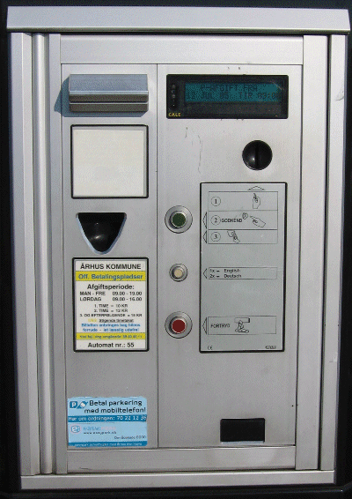

Metaphor: Principle 2
© Henrik Bærbak Christensen

Slide 16
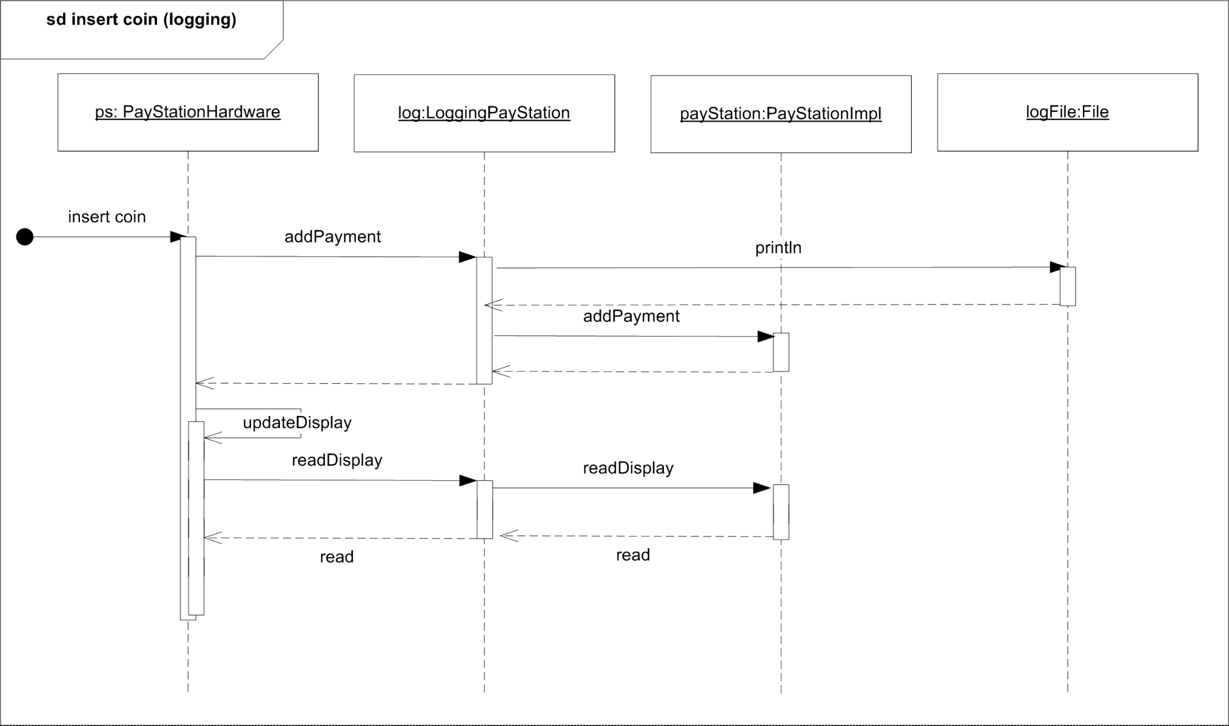
Dynamics
© Henrik Bærbak Christensen

Slide 17
[Demo]
Refactoring process
  Introduce Null Decorator
  Run, see everything pass
  Introduce feature in decorator
© Henrik Bærbak Christensen

Slide 18
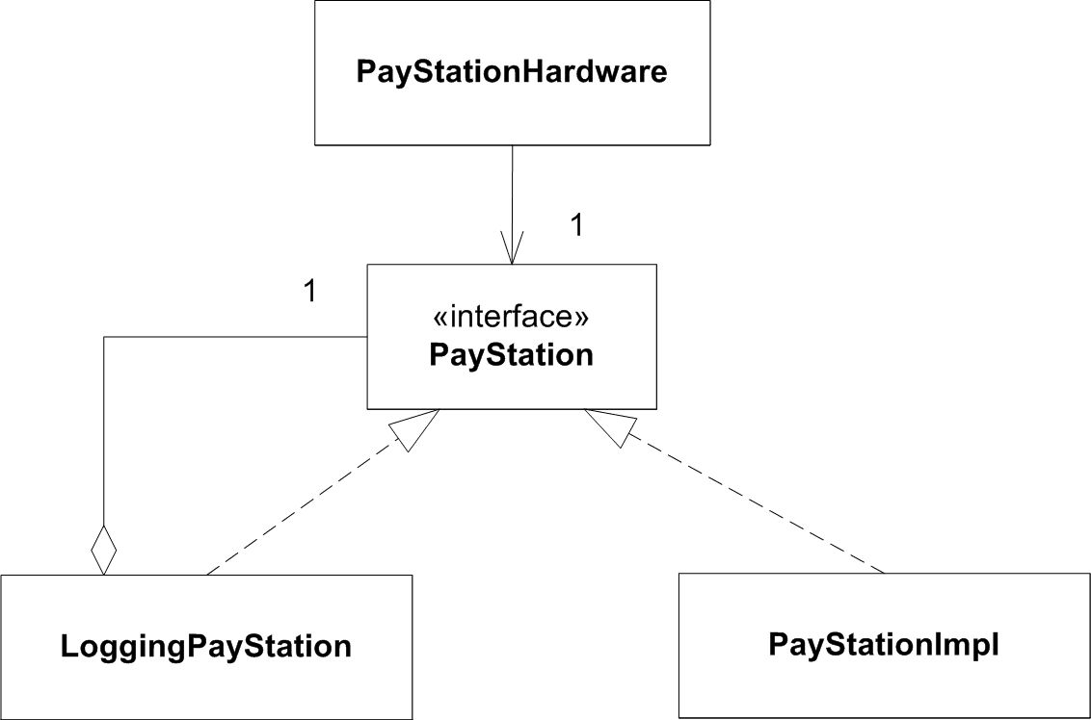
Statics
© Henrik Bærbak Christensen

Slide 19
Chaining decorators
Decorators can form chains.
New requirement:
  no payment possible in 19.00 – 07.00 interval
:PayStationCoinLoggingDecorator
:PayStationFreeParkingInterval
:PayStationImpl
© Henrik Bærbak Christensen

Slide 20
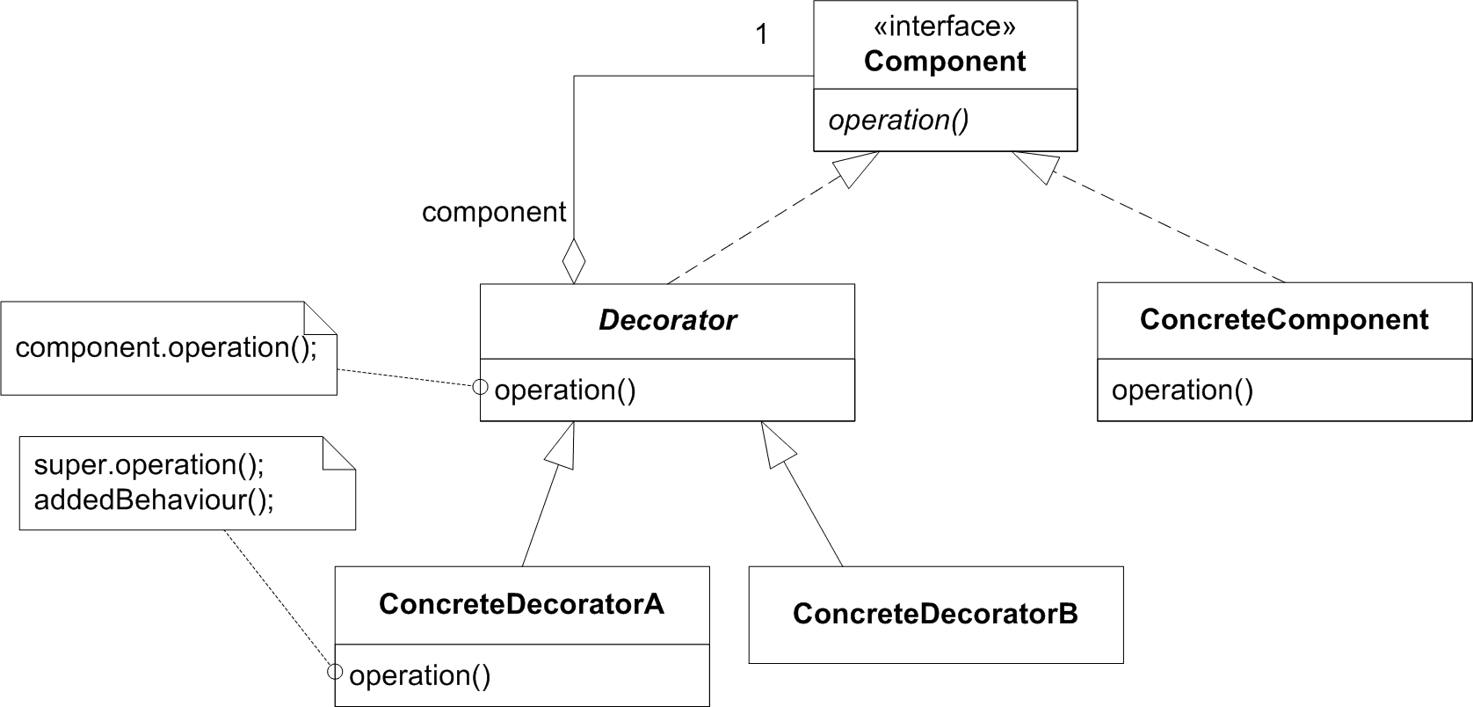
Automagical pattern?
The decorator is yet another application of 3-1-2 and the principles of flexible design!
© Henrik Bærbak Christensen

Slide 21
Consequences
Benefits
  Adding and removing behavior at run-time
  Incrementally add responsibilities
  Complex behavior by chaining decorators
Liabilities
  Analyzability suffers as you end up with lots of little objects
    Behavior is constructed at run-time instead of being written in the static code
  Delegation code tedious to write
    Make a ‘null decorator’ as base class
© Henrik Bærbak Christensen

